Slide 1

LevityAI: Freight Delay Solution
Presented by: Priyanka Taake | Levity AI
Enhancing customer experience with AI
Real-time transparency for customers
Automated delay management solutions

Slide 2
The Challenge: Delays Impact Customer Trust
Freight delays often result from traffic, weather, or congestion.
Customers face inconsistent updates, hurting trust.
Operations teams manually track and inform delays.
💡Opportunity: Automate delay detection and communication using live traffic data and AI-driven messaging.
Levity AI | 2025

Slide 3
Smart, Automated Delay Detection and Communication
1. Monitors live traffic using Google Routes API
2. Calculates delay and checks against threshold
3. Generates AI-based message using OpenAI
4. Evaluates tone and clarity via AI feedback loop
5. Sends notifications via SMS/Email (SendGrid/Twilio)
✅ Benefits:
Real-time transparency
Reduced manual effort
Enhanced customer satisfaction
Levity AI | 2025

Slide 4
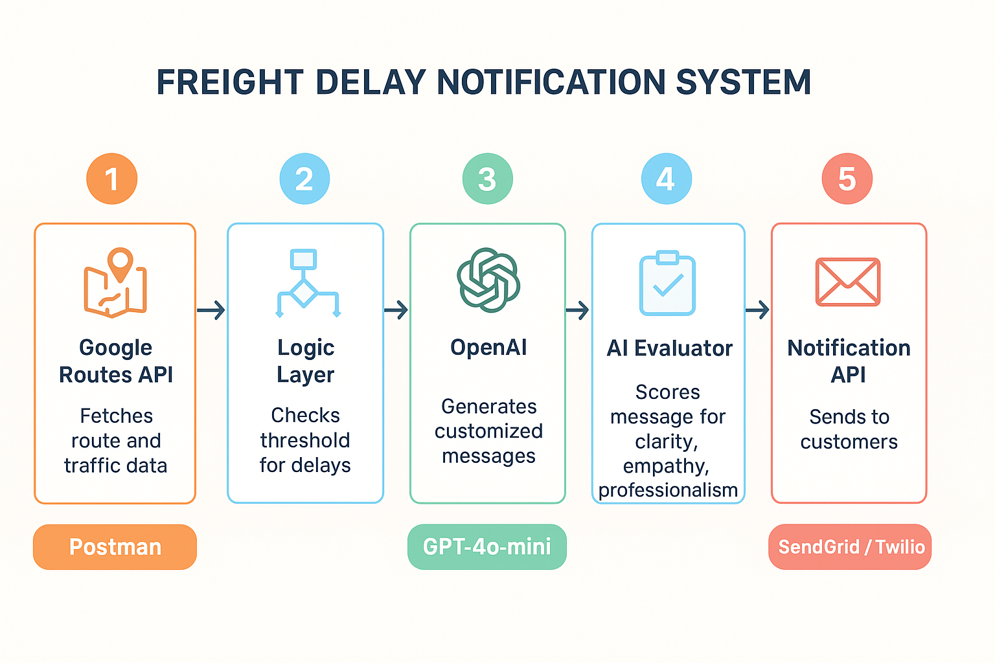
System Workflow Overview
Levity AI | 2025

Slide 5
High-Level Technical Components
Workflow Tool: Postman
Route Data: Google Routes API (real-time computation)
AI Message Generation: OpenAI GPT-4o-mini
AI Evaluation: GPT-4o-mini feedback loop
Notification: Twilio
🔧 Logic: Environment variables, chained API requests, pre-request and test scripts.
Levity AI | 2025

Slide 6
AI Prompt Engineering & Evaluation Logic
Prompt Strategy:
Minor (10–20 min): Friendly tone
Significant (30–60 min): Empathetic tone
Major (>60 min): Highly empathetic and proactive tone
Evaluation Step:
AI re-scores messages (1–5) for clarity, empathy, professionalism
Only messages scoring ≥4 are sent to customers.
Levity AI | 2025

Slide 7
Impact and Future Scope
🎯 Immediate Gains:
Real-time delay detection
Consistent AI-driven communication
Automatic quality control
🚀 Next Steps:
Integrate with freight dashboards
Add multilingual support
Extend to chatbot & voice notifications
Levity AI | 2025

Slide 8
Thank You!
Levity AI | 2025

